Slide 1
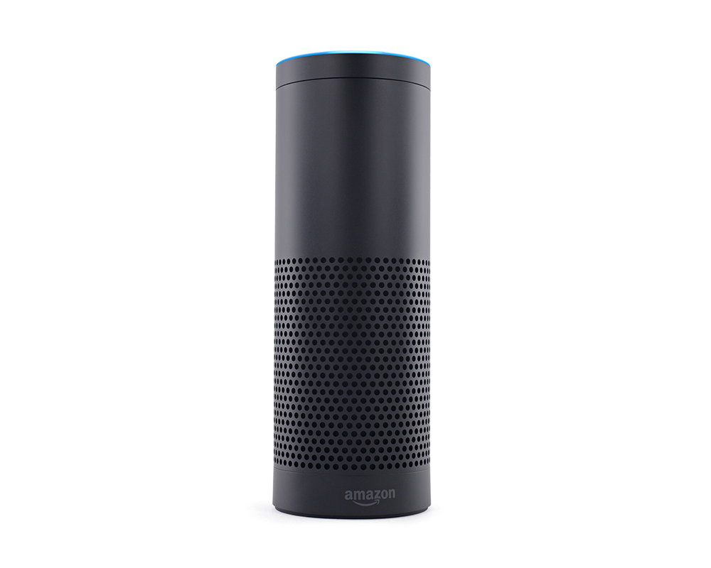
Can You Hear Me Now?

Slide 2

We Live in a World of Science Fiction

Slide 3
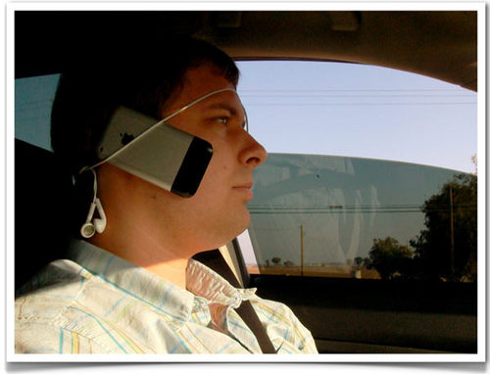
How Do We Create Applications for a Hands Free World?

Slide 4
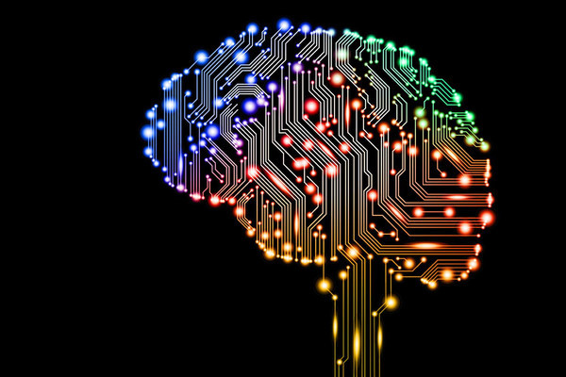
AI and NLP Are Key

Slide 5



Leading the Way

Slide 6
Developing VUI Apps
Define interaction model
Define sample utterances
Define execution endpoint
Voice Engine
Most Systems have separate console
Usually Build in JSON and text files
Receive calls from engine
Execute logic
May call external services
Application Code
Can run almost anywhere
Server-less is current trend (AWS Lambda and Azure Functions)
Language Agnostic
Data services
Pre-defined business apps
External Services
May need to define authentication account
Define data storage model
Define API

Slide 7
Building Alexa Apps

